Slide 1
OFFICIAL SPORTS MEDICINE PARTNER OF MOUNDS VIEW
HIGH SCHOOL

Slide 2
SPORTS MEDICINE EXPERTS
Summit's fellowship-trained sports medicine experts diagnose and treat the full spectrum of sports-related injuries.
We partner with the athlete, parents, athletic trainer and coach to design a personalized treatment plan aimed to safely accelerate your recovery, so you spend less time in the doctor's office and more time getting back to what you love.

Slide 3
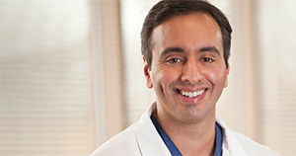
TEAM PHYSICIAN Eric Khetia, M.D.
DR. KHETIA’S APPROACH TO CARE
“My goal is to lead an active, healthy life and to allow my patients to do the same. Restoring them to pre-injury levels of functioning and allowing them to pursue the activities they enjoy inspires me.”
Background and education
Dr. Khetia completed his undergraduate and medical studies at the University of Missouri in Kansas City, Missouri. For his residency, he participated in the Orthopedic Surgery program at the University of Kansas in Wichita, Kansas. He then went on to complete an Arthroscopic Surgery and Sports Medicine fellowship at New England Baptist Hospital in Boston, MA.
SPECIALTIES
Sports & Active Medicine
Shoulder & Knee Care

Slide 4
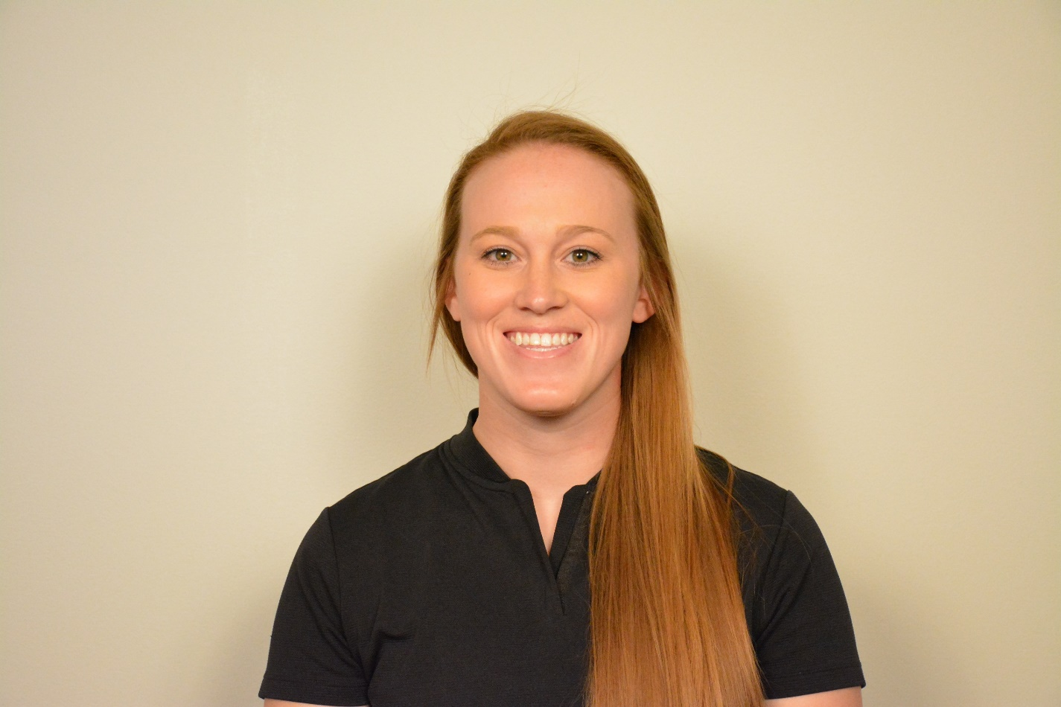
MOUNDS VIEW ATHLETIC TRAINER KATIE ESPE, MAT, LAT, ATC
HOURS: 2-6, later on game nights
LOCATION: Behind the weight room
EMAIL: kespe@summitortho.com

Slide 5
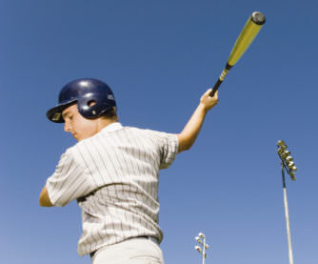
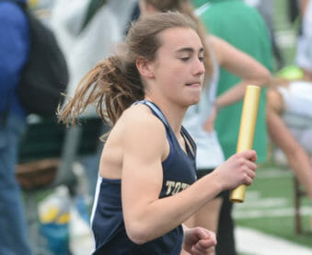
PREVENTION
My goal is to keep you healthy so that you can have a successful season.
Athletes: If you are feeling an ache/pain or suspect an injury, please see me right away. I can help you best if you see me early. If you wait until the day before or day of the game/meet/match, there will be limitations in how I can provide treatment for your injury.

Slide 6
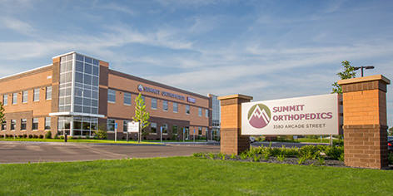
WALK IN CARE @ VADNAIS LOCATION
3580 Arcade Street South Vadnais Heights, MN 55127
Conveniently located off I-35 and Co Rd E adjacent to Walmart.
Orthopedic urgent care, is open seven days a week, from 8:00 a.m. to 8:00 p.m.
Walk-In Available 8 am to 8 pm Daily

Slide 7
IN THE EVENT OF INJURY
Because of my affiliation with Summit, I have 24/7 access to your team physician Dr. Khetia and together we can assess your needs.
We will do our best to keep you out of the clinic and back on the field ASAP. But, if you do need to see a physician, we will get you in to the right specialist and help schedule the appointment.
You have the ability to go to any clinic you would like – but please know that if you want to return to play – I will need a doctor’s note. Without it, the MSHSL will not let you return. If you do go somewhere other than Summit, I can’t guarantee how long that doctor will keep you out due to injury.
TWIN CITIES METRO LOCATIONS

